Slide 1

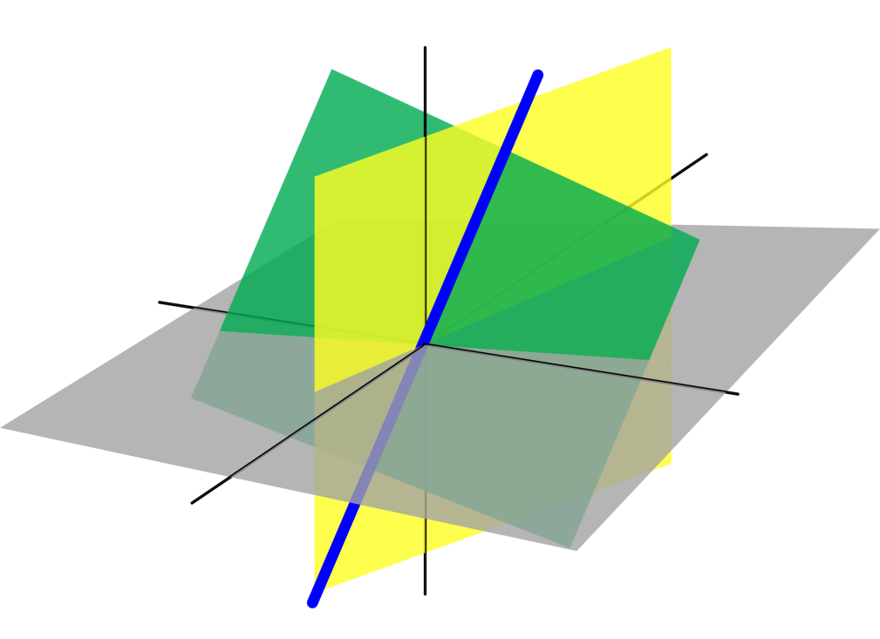
Azərbaycan Dövlət Neft və Sənaye Universiteti
Analytical Geometry

Slide 2
Surfaces in Space

Slide 3
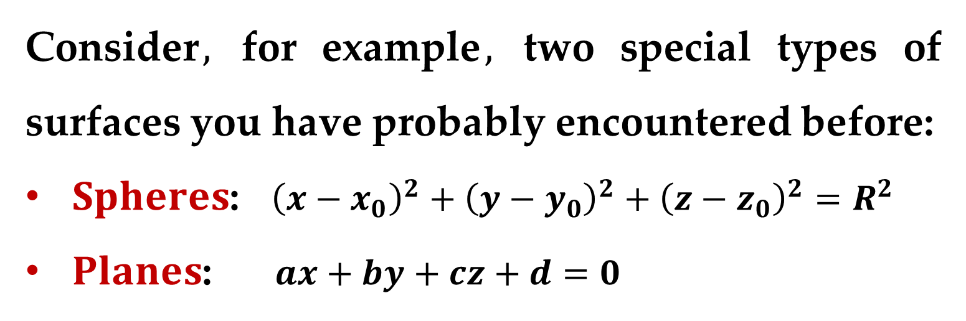
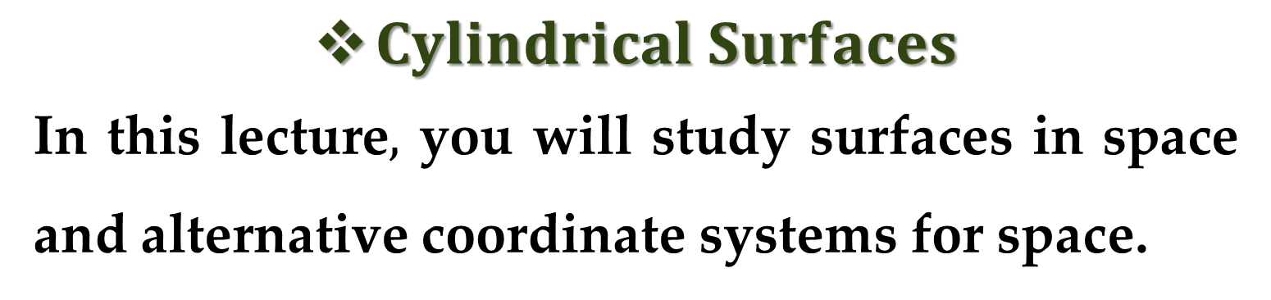
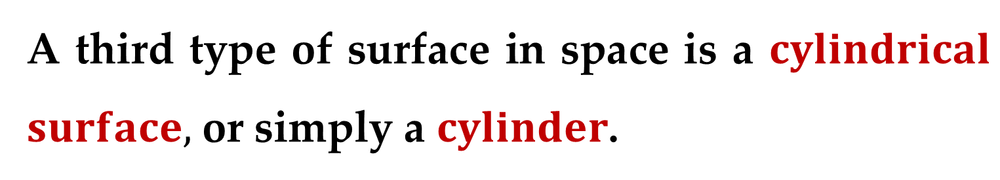
$Cylindrical Surfaces$
In this lecture$,$ you will study surfaces in space and alternative coordinate systems for space.
Consider$,$ for example$,$ two special types of surfaces you have probably encountered before:
$Spheres$: ${\left(x−x_{0}\right)}^{2}+{\left(y−y_{0}\right)}^{2}+{\left(z−z_{0}\right)}^{2}=R^{2}$
$Planes$: $ax+by+cz+d=0$
A third type of surface in space is a $cylindrical$ $surface,$ or simply a $cylinder$.

Slide 4
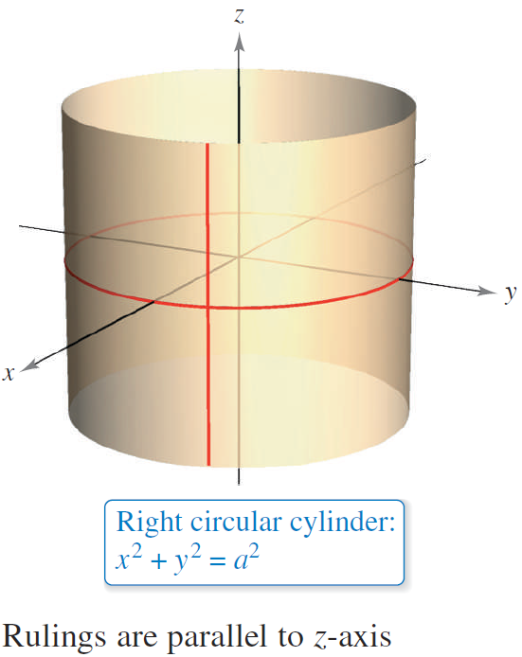
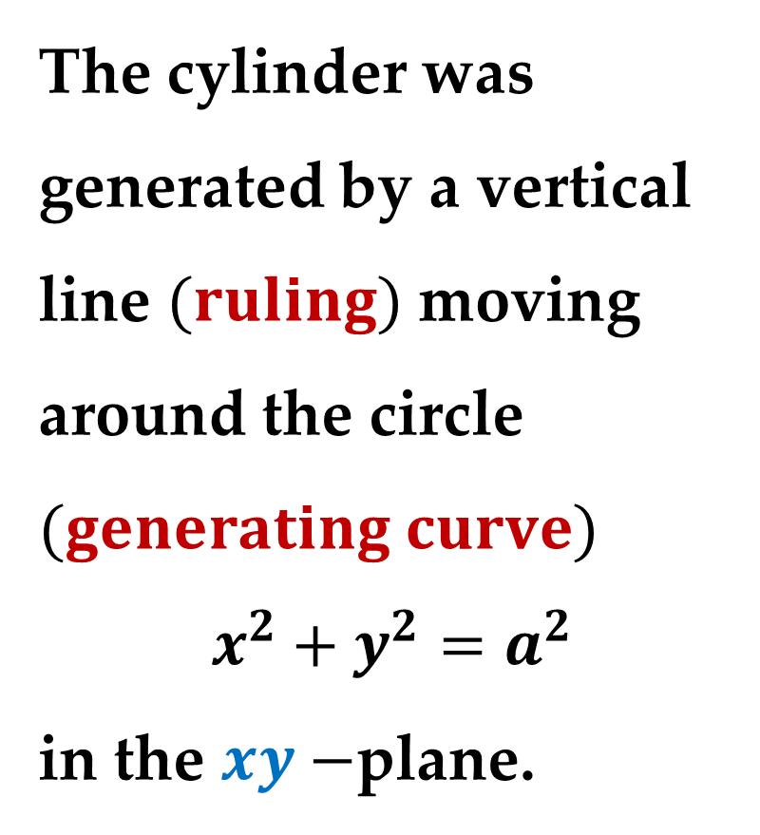
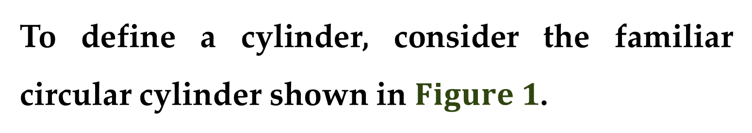
To define a cylinder, consider the familiar circular cylinder shown in $Figure 1$.
The cylinder was generated by a vertical line $(ruling)$ moving around the circle $(generating curve)$
$$x^{2}+y^{2}=a^{2}$$
in the $xy−$plane.

Slide 5
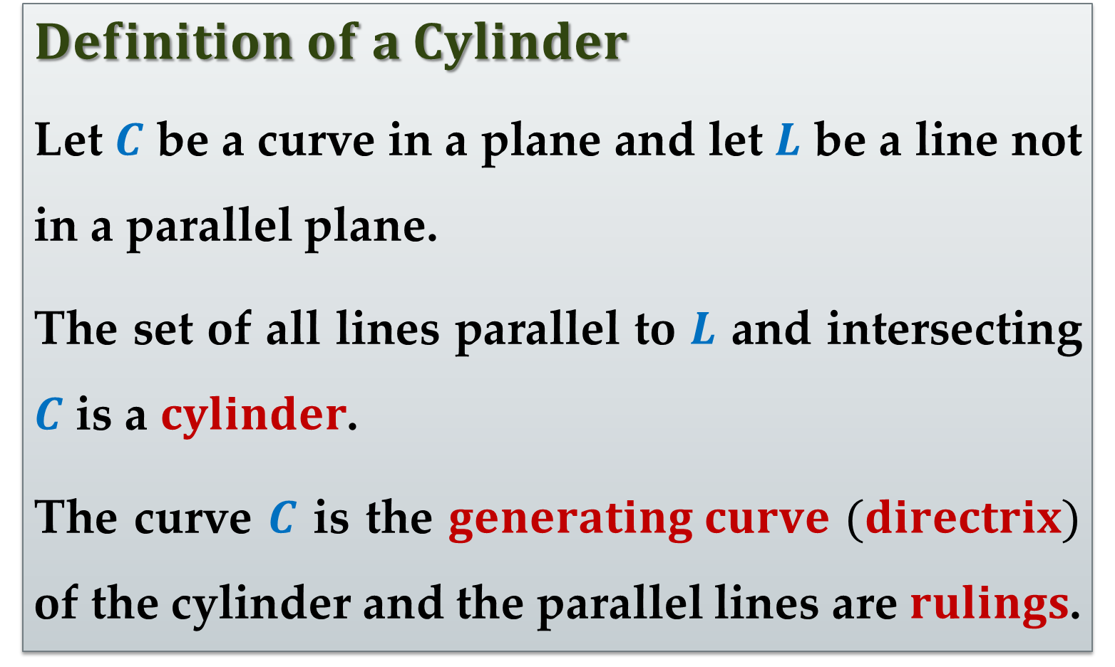
$$Definition of a Cylinder$$
Let $C$ be a curve in a plane and let $L$ be a line not in a parallel plane.
The set of all lines parallel to $L$ and intersecting $C$ is a $cylinder$.
The curve $C$ is the $generating curve$ $(directrix)$ of the cylinder and the parallel lines are $rulings$.

Slide 6
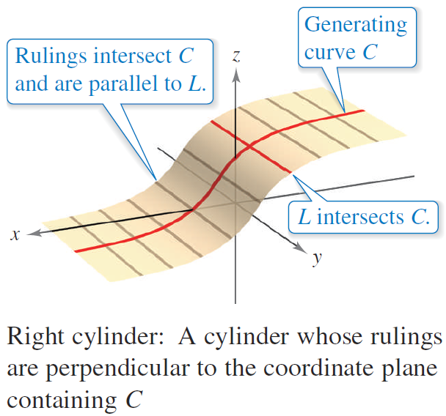
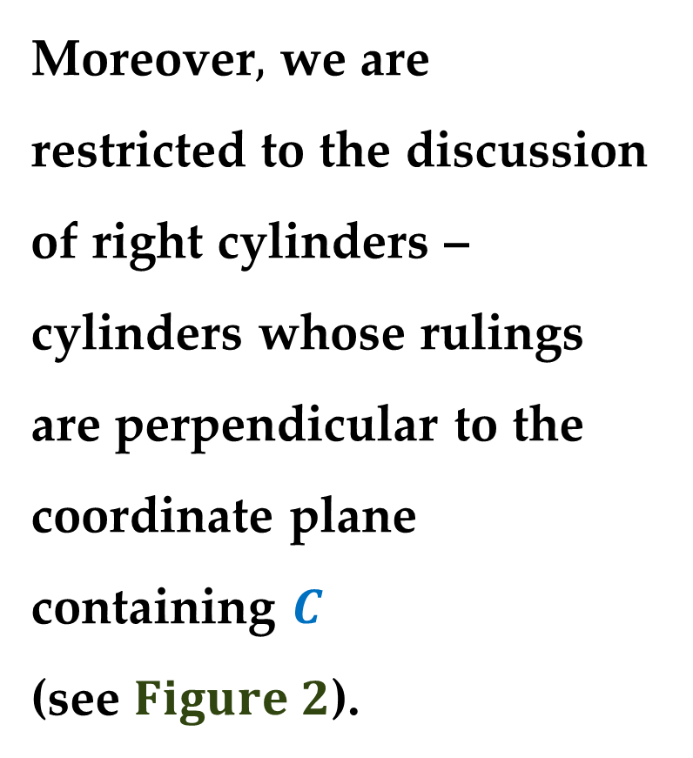
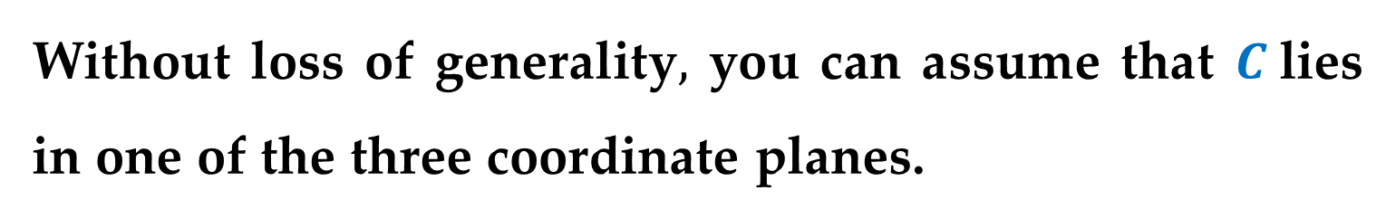
Without loss of generality$,$ you can assume that $C$lies in one of the three coordinate planes.
Moreover$,$ we are restricted to the discussion of right cylinders – cylinders whose rulings are perpendicular to the coordinate plane containing $C$
(see $Figure 2$).

Slide 7
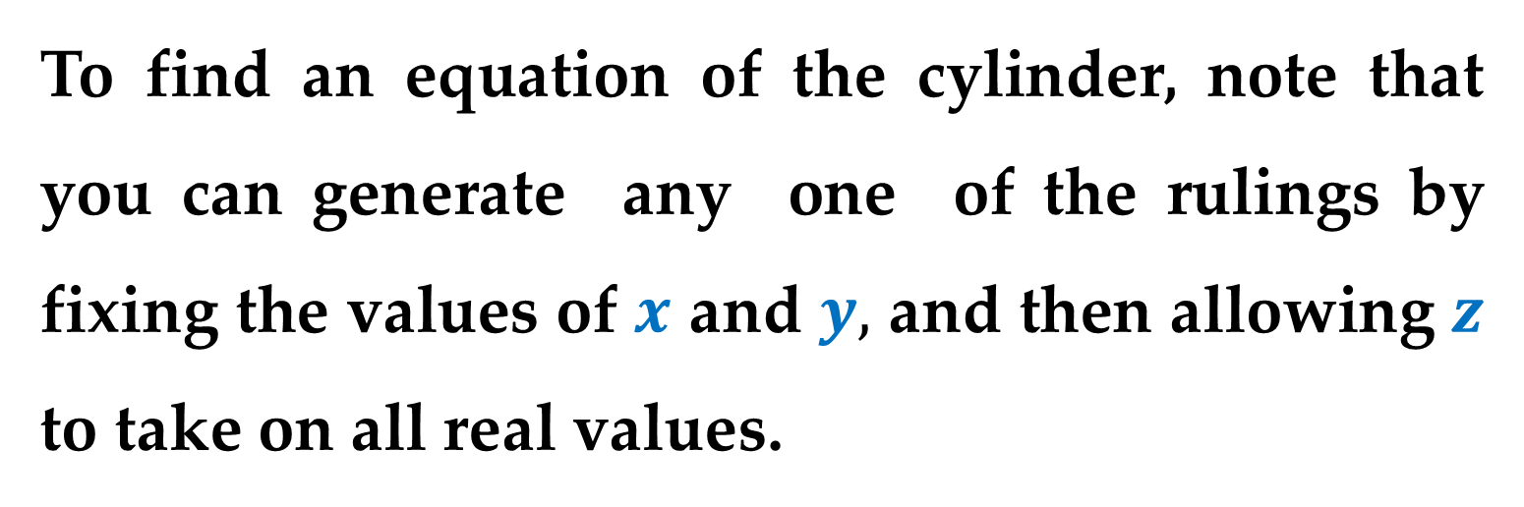
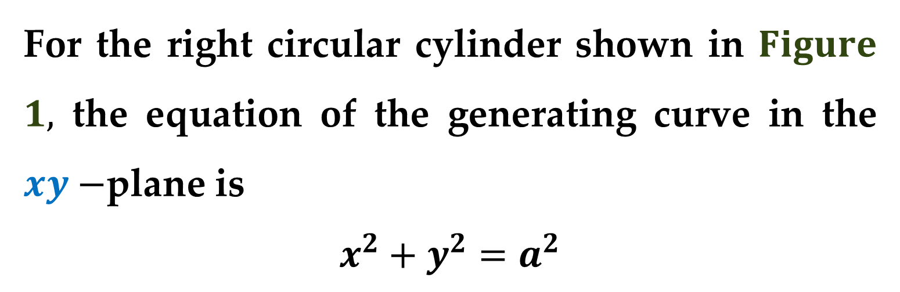
For the right circular cylinder shown in $Figure$ $1,$ the equation of the generating curve in the $xy−$plane is
$$x^{2}+y^{2}=a^{2}$$
To find an equation of the cylinder, note that you can generate any one of the rulings by fixing the values of $x$ and $y,$ and then allowing $z$ to take on all real values.

Slide 8
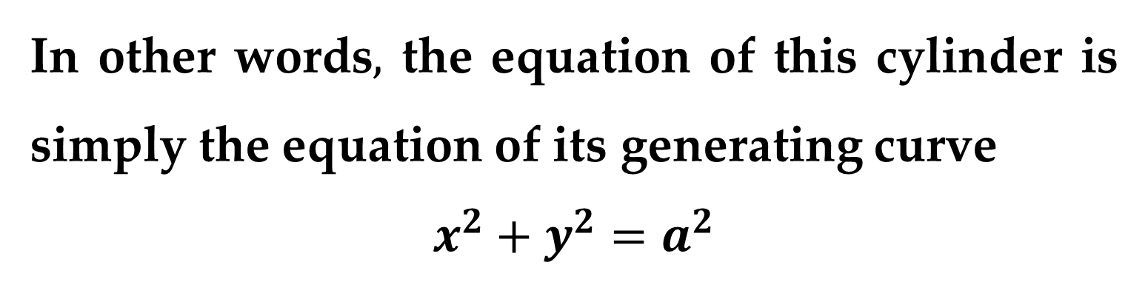
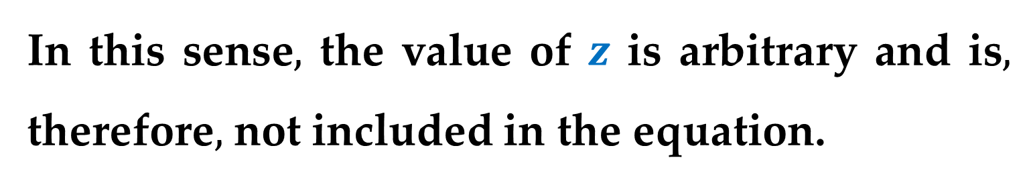
In this sense$,$ the value of $z$ is arbitrary and is$,$ therefore$,$ not included in the equation.
In other words$,$ the equation of this cylinder is simply the equation of its generating curve
$$x^{2}+y^{2}=a^{2}$$
The equation of a cylinder whose rulings are parallel to one of the coordinate axes contains only the variables corresponding to the other two axes.

Slide 9
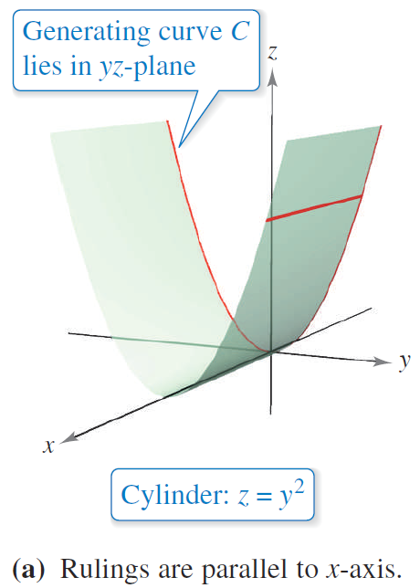
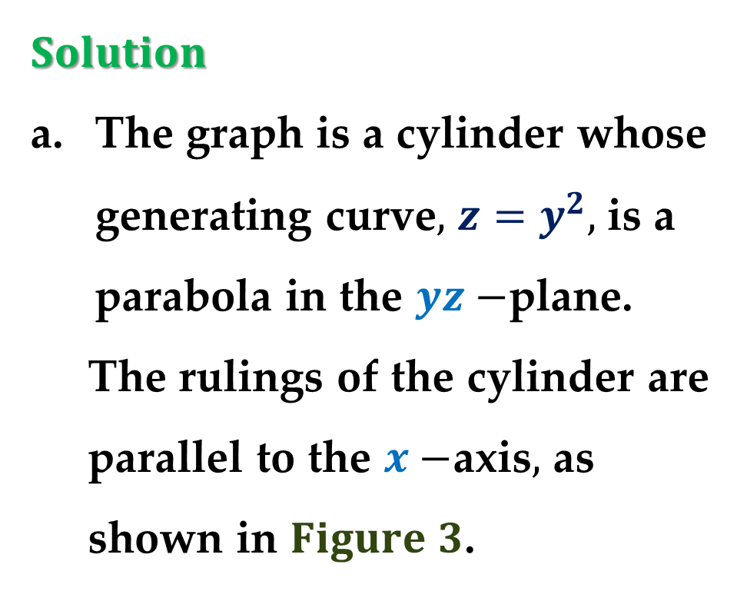
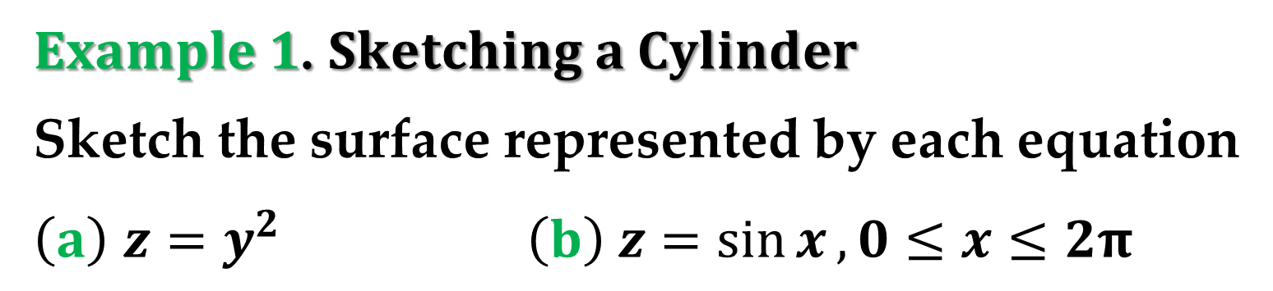
$Example 1$. $Sketching a Cylinder$
Sketch the surface represented by each equation
$\left(a\right)$ $z=y^{2}$ $\left(b\right) z=\sin{x}, 0≤x≤2π$
$Solution$
The graph is a cylinder whose generating curve$,$ $z=y^{2},$ is a parabola in the $yz−$plane.
The rulings of the cylinder are parallel to the $x−$axis$,$ as shown in $Figure 3$.

Slide 10
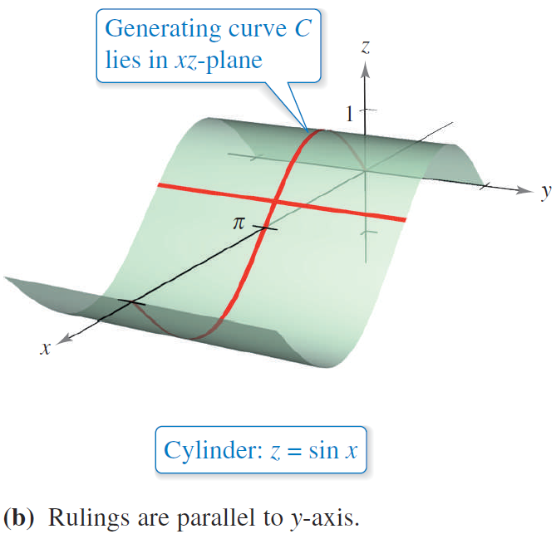
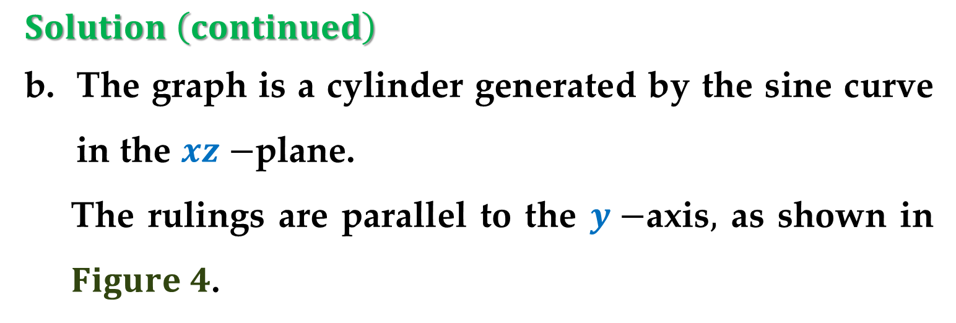
$Solution \left(continued\right)$
The graph is a cylinder generated by the sine curve in the $xz−$plane.
The rulings are parallel to the $y−$axis$,$ as shown in $Figure 4$.

Slide 11
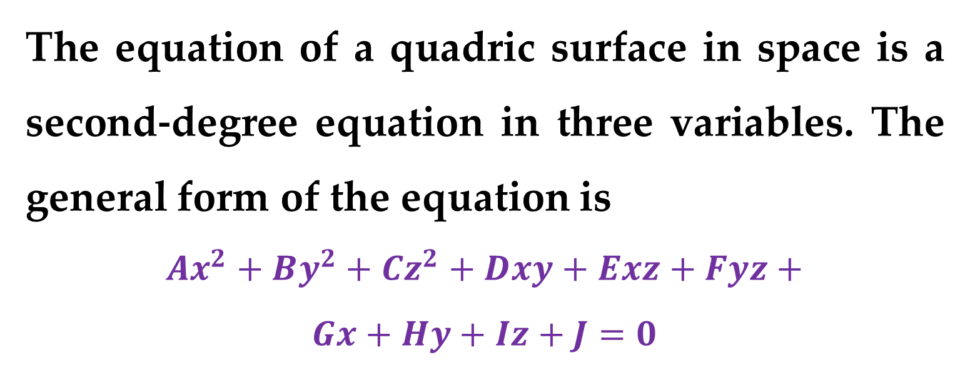
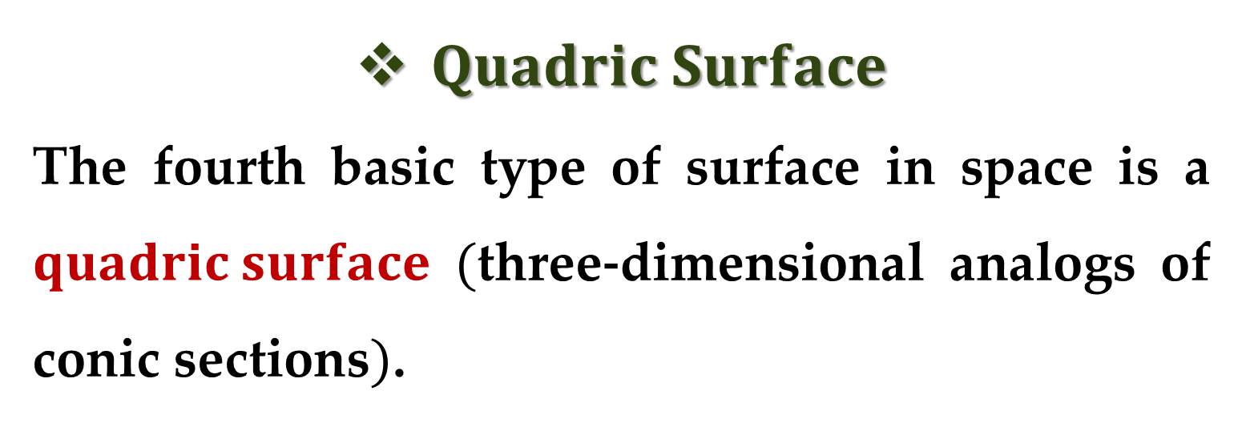
$Quadric Surface$
The fourth basic type of surface in space is a $quadric surface$ $($three-dimensional analogs of conic sections$)$.
The equation of a quadric surface in space is a second-degree equation in three variables. The general form of the equation is
$$Ax^{2}+By^{2}+Cz^{2}+Dxy+Exz+Fyz+$$
$$Gx+Hy+Iz+J=0$$

Slide 12
There are six basic types of quadric surfaces:
ellipsoid
hyperboloid of one sheet
hyperboloid of two sheets
elliptic cone
elliptic paraboloid
hyperbolic paraboloid.

Slide 13
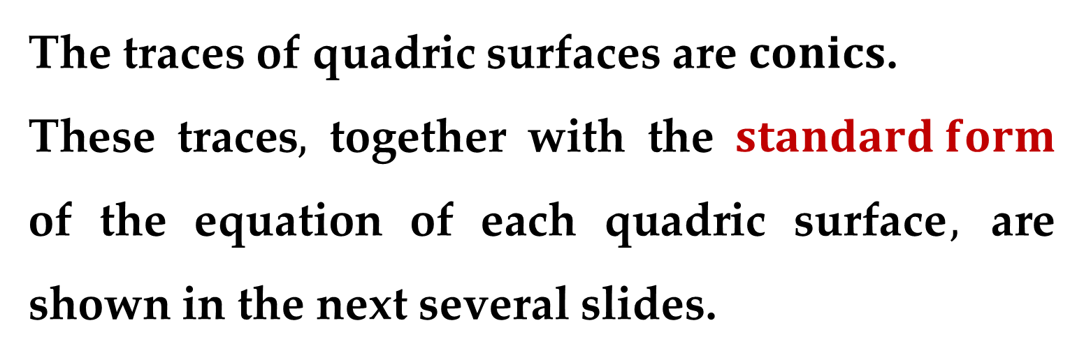
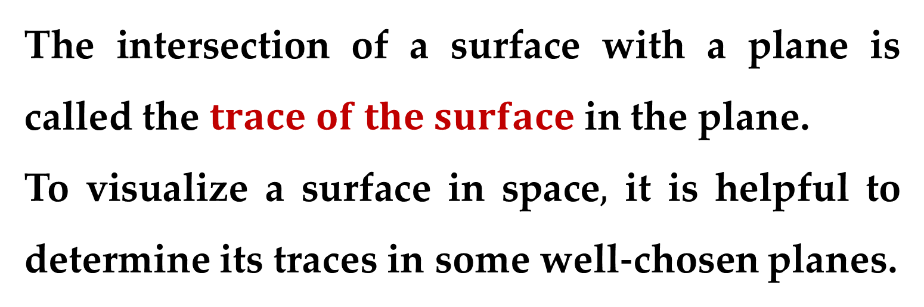
The intersection of a surface with a plane is called the $trace of the surface$ in the plane.
To visualize a surface in space$,$ it is helpful to determine its traces in some well-chosen planes.
The traces of quadric surfaces are $conics$.
These traces$,$ together with the $standard form$ of the equation of each quadric surface$,$ are shown in the next several slides.

Slide 14
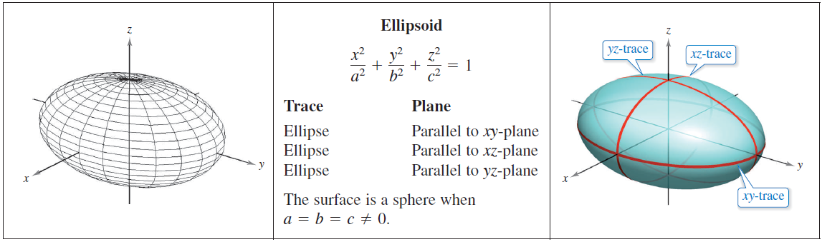
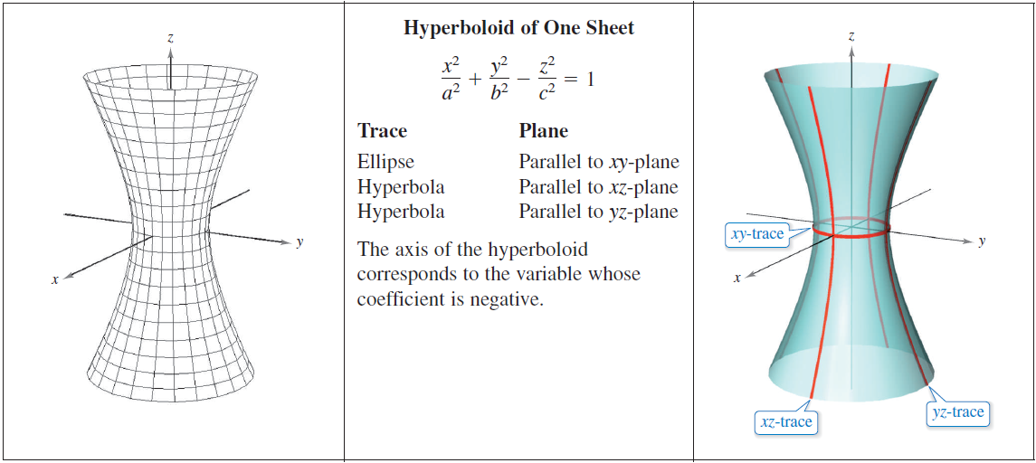

Slide 15
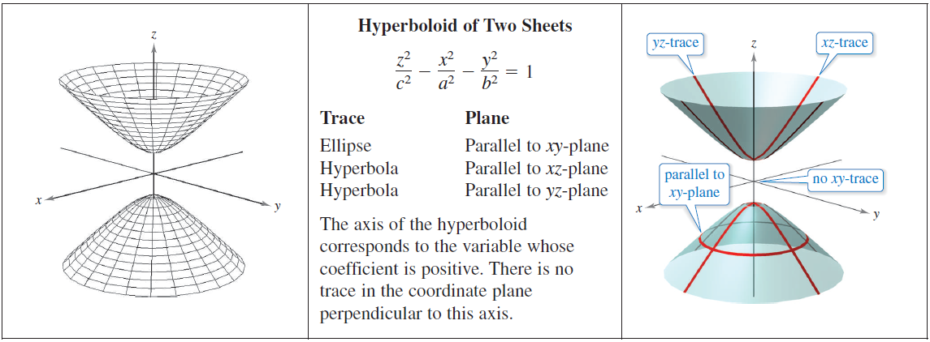
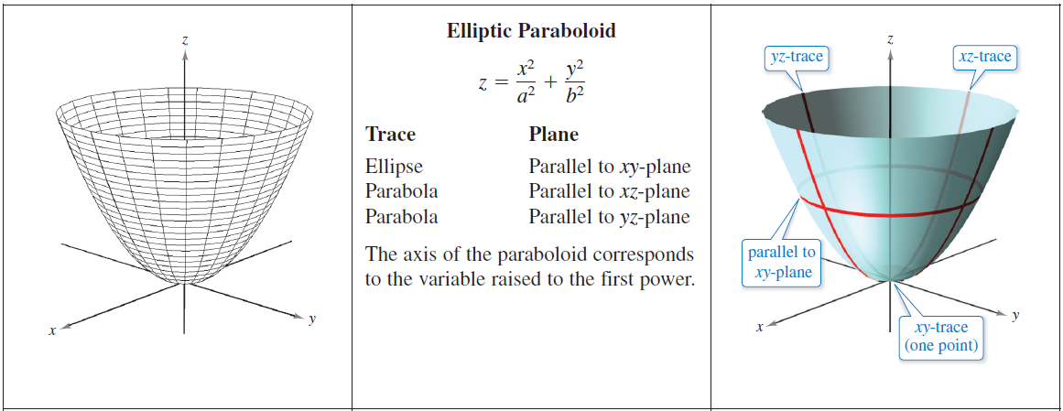

Slide 16
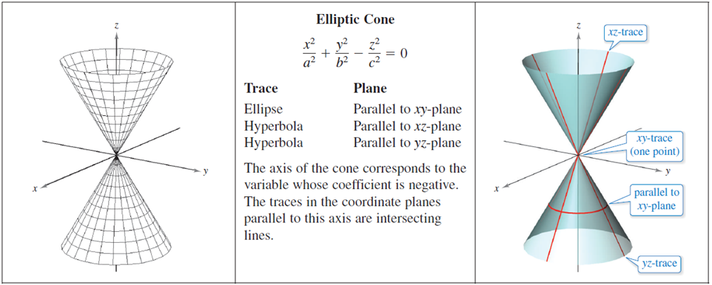
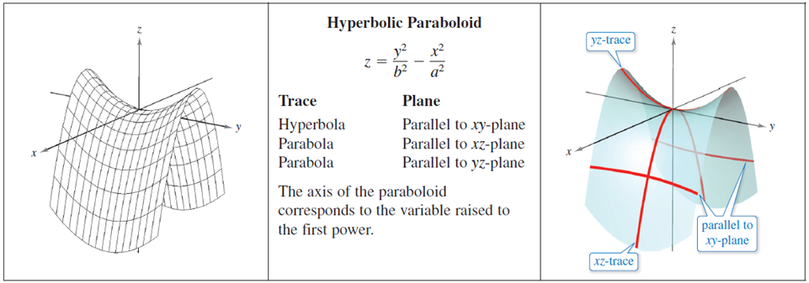

Slide 17
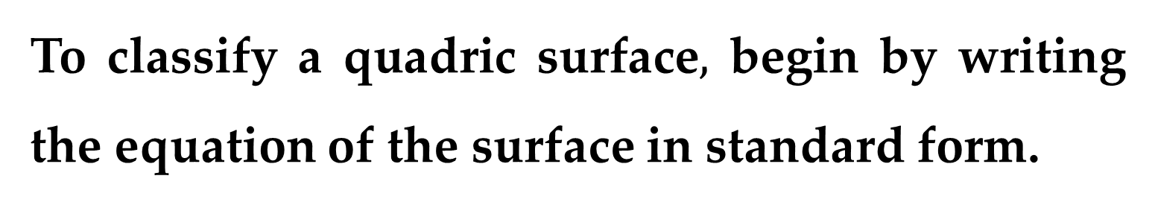
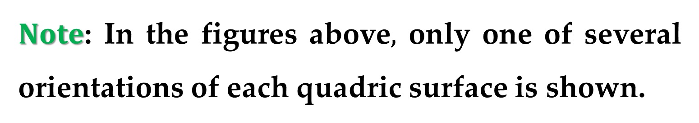
$Note$: In the figures above$,$ only one of several orientations of each quadric surface is shown.
When the surface is oriented along a different axis, its standard equation will change accordingly.
To classify a quadric surface$,$ begin by writing the equation of the surface in standard form.

Slide 18
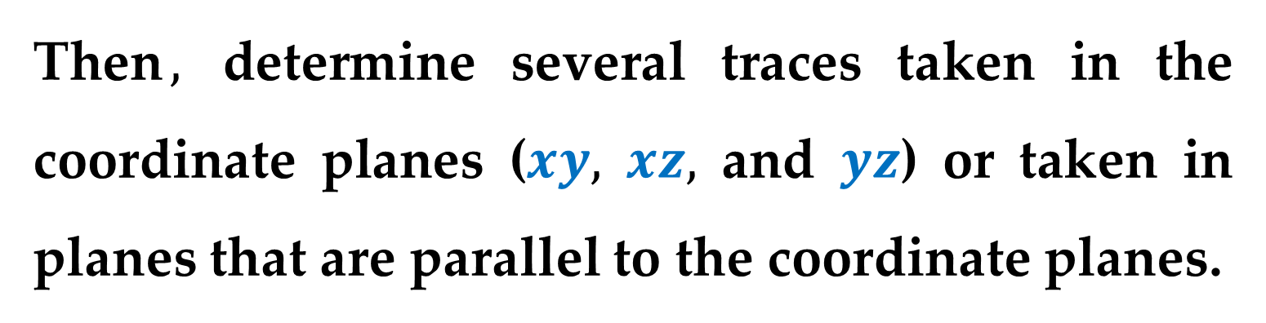
Then$,$ determine several traces taken in the coordinate planes ($xy,$ $xz,$ and $yz$) or taken in planes that are parallel to the coordinate planes.

Slide 19
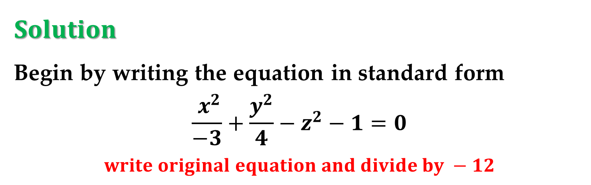
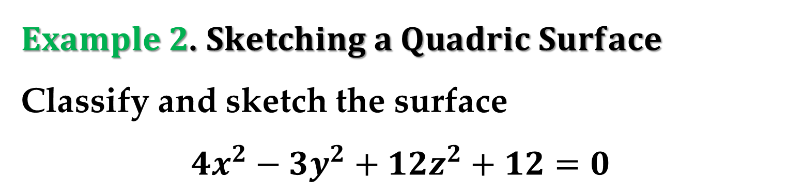

$Example 2$. $Sketching a Quadric Surface$
Classify and sketch the surface
$$4x^{2}−3y^{2}+12z^{2}+12=0$$
$Solution$
Begin by writing the equation in standard form
$$\frac{{ x}^{2}}{−3}+\frac{y^{2}}{4}−z^{2}−1=0$$
$$write original equation and divide by −12$$
$$\frac{y^{2}}{4}−\frac{{ x}^{2}}{3}−\frac{z^{2}}{1}=1$$
$$\text{standard} \text{form}$$

Slide 20
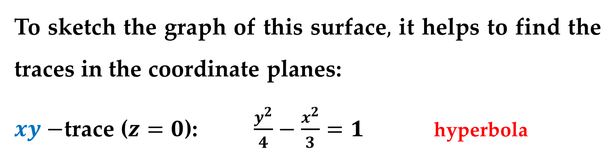
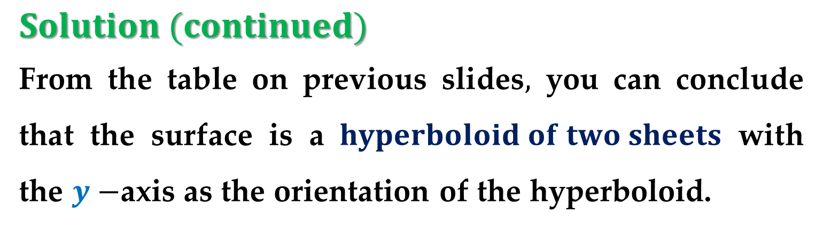
$Solution (continued)$
From the table on previous slides$,$ you can conclude that the surface is a $hyperboloid of two sheets$ with the $y−$axis as the orientation of the hyperboloid.
To sketch the graph of this surface$,$ it helps to find the traces in the coordinate planes:
$xy−$trace ($z=0$): $\frac{y^{2}}{4}−\frac{x^{2}}{3}=1$ hyperbola
$xz−$trace ($y=0$): $\frac{x^{2}}{3}+\frac{z^{2}}{1}=−1$ no trace
$yz−$trace ($x=0$): $\frac{y^{2}}{4}−\frac{z^{2}}{1}=1$ hyperbola

Slide 21
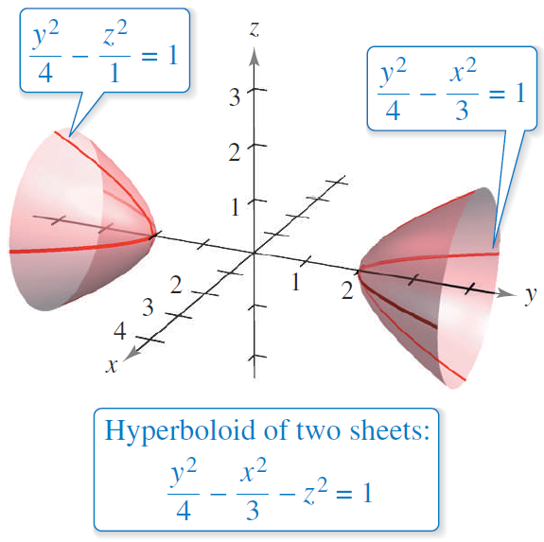
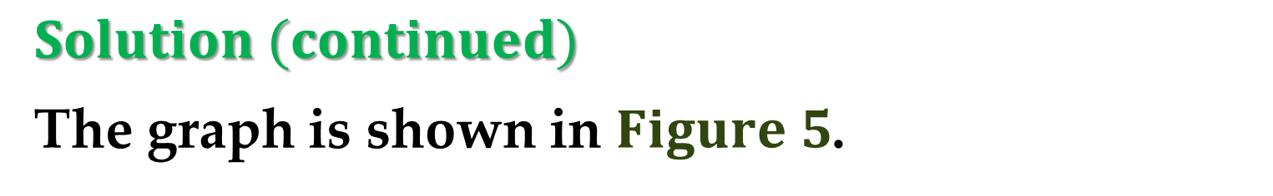
$Solution (continued)$
The graph is shown in $Figure 5$.

Slide 22
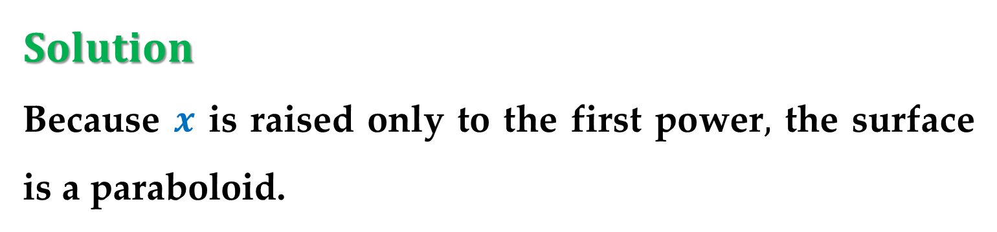
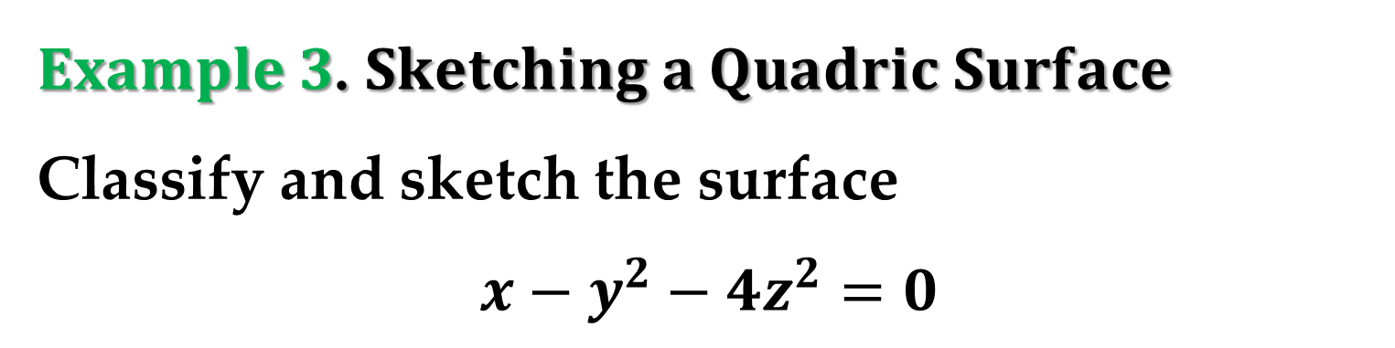
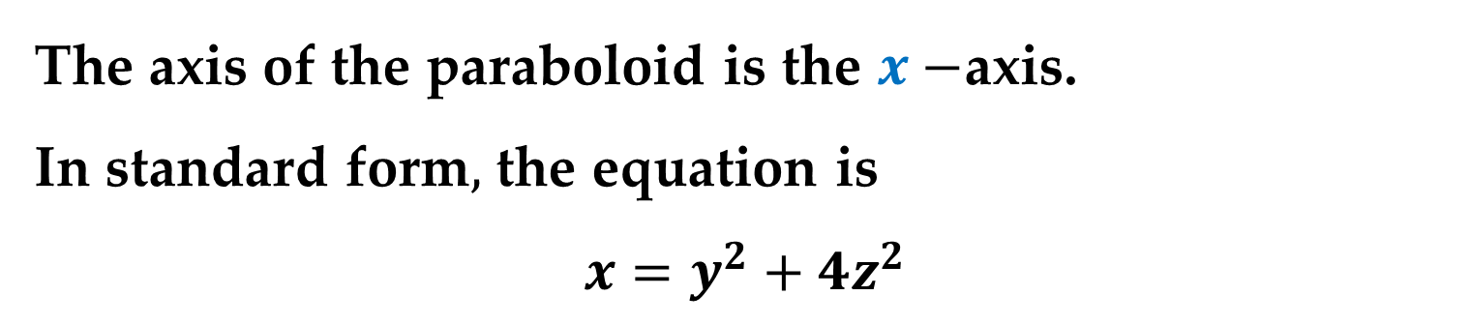
$Example 3$. $Sketching a Quadric Surface$
Classify and sketch the surface
$$x−y^{2}−4z^{2}=0$$
$Solution$
Because $x$ is raised only to the first power$,$ the surface is a paraboloid.
The axis of the paraboloid is the $x−$axis.
In standard form$,$ the equation is
$$x=y^{2}+4z^{2}$$

Slide 23
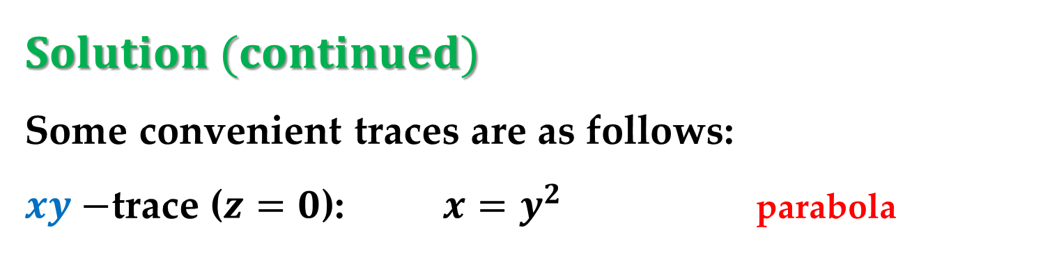
$Solution (continued)$
Some convenient traces are as follows:
$xy−$trace ($z=0$): $x=y^{2}$ parabola
$xz−$trace ($y=0$): $x=4z^{2}$ parabola
Parallel to $yz−$plane ($x=4$): $\frac{y^{2}}{4}+\frac{z^{2}}{1}=1$ ellipse

Slide 24
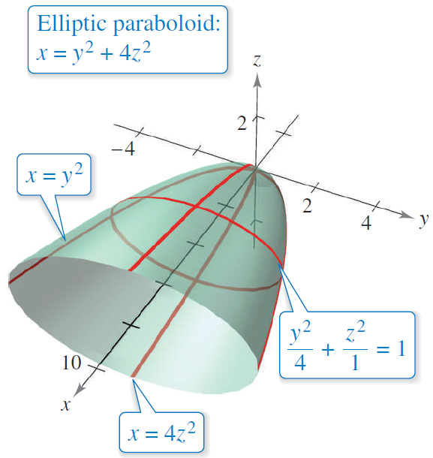
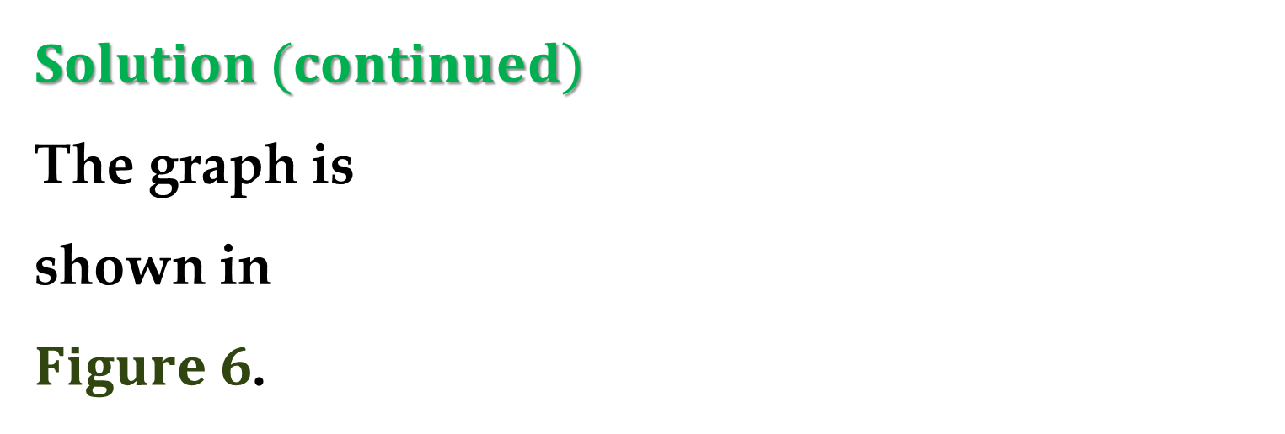
$Solution (continued)$
The graph is
shown in
$Figure 6$.

Slide 25
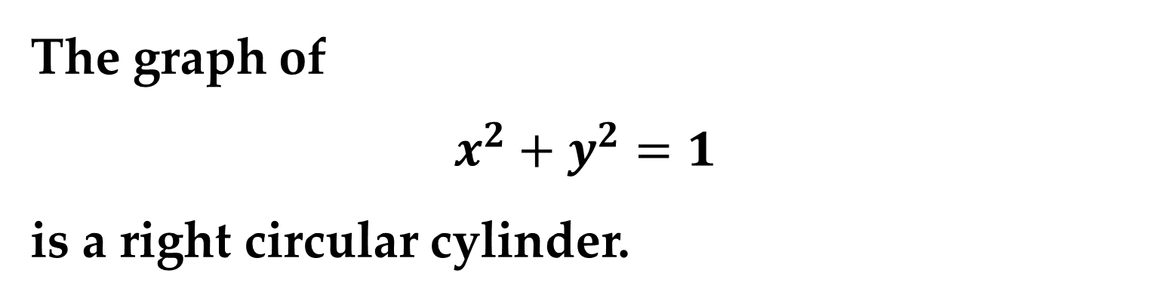
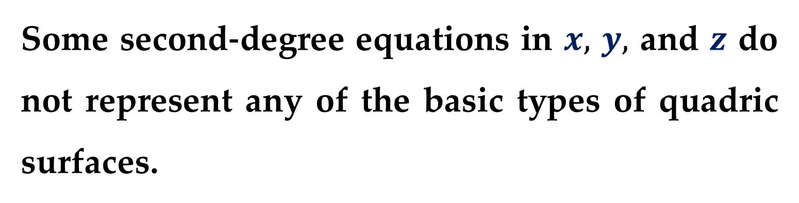
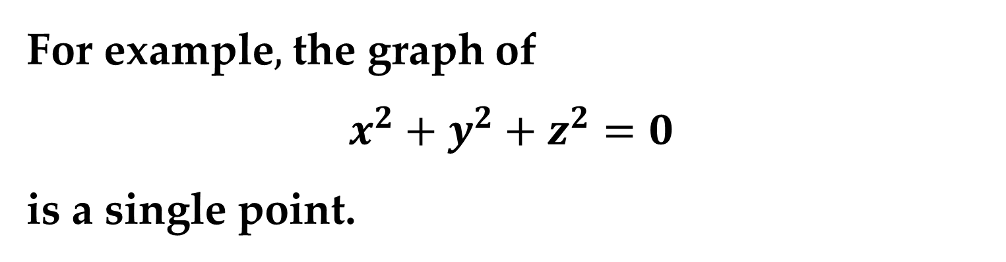
Some second-degree equations in $x,$ $y,$ and $z$ do not represent any of the basic types of quadric surfaces.
For example$,$ the graph of
$$x^{2}+y^{2}+z^{2}=0$$
is a single point.
The graph of
$$x^{2}+y^{2}=1$$
is a right circular cylinder.

Slide 26
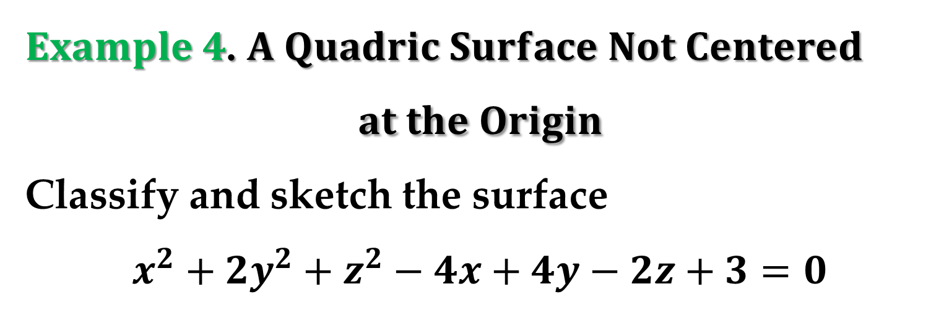
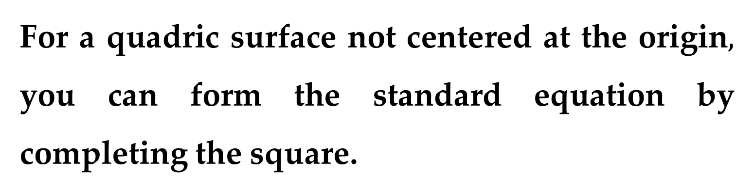
For a quadric surface not centered at the origin$,$ you can form the standard equation by completing the square.
$Example 4$. $A Quadric Surface Not Centered$
$$at the Origin$$
Classify and sketch the surface
$$x^{2}+2y^{2}+z^{2}−4x+4y−2z+3=0$$

Slide 27



$Solution$
Begin by grouping terms and factoring where possible
$$\left(x^{2}−4x+0\right)+2\left(y^{2}+2y+0\right)+\left(z^{2}−2z+0\right)=−3$$
$$\left(x^{2}−4x+4\right)+2\left(y^{2}+2y+1\right)+\left(z^{2}−2z+1\right)=$$
$$=−3+4+2+1$$
$${\left(x−2\right)}^{2}+2{\left(y+1\right)}^{2}+{\left(z−1\right)}^{2}=4$$
$$\frac{{\left(x−2\right)}^{2}}{4}+\frac{{\left(y+1\right)}^{2}}{2}+\frac{{\left(z−1\right)}^{2}}{4}=1$$

Slide 28


$Solution (continued)$
From this equation, you can see that the quadric surface is an ellipsoid that is centered at $\left(2,−1,1\right)$.
Its graph is shown in $Figure 7$.

Slide 29

$$Technological Note$$
A $3−$D graphing utility can help you visualize a surface in space.
Such a graphing utility may create a three-dimensional graph by sketching several traces of the surface and then applying a $“$hidden-line$”$ routine that blocks out portions of the surface that lie behind other portions of the surface.

Slide 30


Let’s draw, for example, two surfaces represented by equations
$$x=\frac{y^{2}}{2}+\frac{z^{2}}{2} z=\frac{y^{2}}{16}−\frac{x^{2}}{16}$$
elliptic paraboloid hyperbolic paraboloid
To sketch these surfaces in MATLAB, we can use the built-in function called
$$fimplicit3\left(@\left(x,y,z\right)\right)$$

Slide 31



$Surfaces of Revolution$
The fifth special type of surface is a $surface of$ $revolution$.
Consider the graph of
the radius function
$y=r\left(z\right)$
$generating curve$
in the $yz−$plane.

Slide 32



When this graph is revolved about the axis$,$ it forms a surface of revolution$,$ as shown in $Figure 8$ above.
The trace of the surface in the plane $z=z_{0}$ is a circle whose radius is $r\left(z_{0}\right)$ and whose equation is
$x^{2}+y^{2}={\left[r\left(z_{0}\right)\right]}^{2}$ $circular trace in plane: z=z_{0}$
Replacing $z_{0}$ with $z$ produces an equation that is valid for all values of $z$.

Slide 33

In a similar manner$,$ you can obtain equations for surfaces of revolution for the other two axes$,$ and the results are summarized below.

Slide 34

$$Surface of Revolution$$
If the graph of a radius function $r$ is revolved about one of the coordinate axes, then the equation of the resulting surface of revolution has one of the forms listed below.
Revolved about the $x−$axis: $y^{2}+z^{2}={\left[r\left(x\right)\right]}^{2}$
Revolved about the $y−$axis: $x^{2}+z^{2}={\left[r\left(y\right)\right]}^{2}$
Revolved about the $z−$axis: $x^{2}+y^{2}={\left[r\left(z\right)\right]}^{2}$

Slide 35

$Example 5$. $Finding an Equation for a$
$$Surface of Revolution$$
Find an equation for the surface of revolution formed by revolving
$\left(a\right)$ the graph of $y=1/z$ about the $z−$axis;
$\left(b\right)$ the graph of $9x^{2}=y^{3}$ about the $y−$axis.

Slide 36

$Solution$
An equation for the surface of revolution formed by revolving the graph of $y=\frac{1}{z}$ about the $z−$axis is
$$x^{2}+y^{2}={\left[r\left(z\right)\right]}^{2} →$$
$$x^{2}+y^{2}={\left[\frac{1}{z}\right]}^{2}$$

Slide 37


$Solution (continued)$
To find an equation for the surface formed by revolving the graph of $9x^{2}=y^{3}$ about the $y−$axis$,$ solve for $x$ in terms of $y$ to obtain
$$x=\frac{1}{3}y^{\frac{3}{2}}=r\left(y\right)$$
So the equation for this surface is
$$x^{2}+z^{2}={\left[r\left(y\right)\right]}^{2} →$$
$$x^{2}+z^{2}={\left[\frac{1}{3}\sqrt{y^{3}}\right]}^{2} →$$
$$x^{2}+z^{2}=\frac{1}{9}y^{3}$$

Slide 38


$Solution (continued)$
The graph is
shown in
$Figure 9$.

Slide 39

The generating curve for a surface of revolution is not unique. For instance$,$ the surface
$$x^{2}+z^{2}=e^{−2y}$$
can be formed by revolving either
the graph of
$$x=e^{−y}$$
about the $y−$axis
the graph of
$$z=e^{−y}$$
about the $y−$axis

Slide 40


$Example 6$. $Finding a Generating Curve$
Find a generating curve and the axis of revolution for the surface
$$x^{2}+3y^{2}+z^{2}=9$$

Slide 41


$Solution$
The equation has one of the forms listed below
$x^{2}+y^{2}={\left[r\left(z\right)\right]}^{2}$ revolved about $z−$axis
$y^{2}+z^{2}={\left[r\left(x\right)\right]}^{2}$ revolved about $x−$axis
$x^{2}+z^{2}={\left[r\left(y\right)\right]}^{2}$ revolved about $y−$axis
Because the coefficients of $x^{2}$ and $z^{2}$ are equal$,$ you should choose the third form and write
$$x^{2}+z^{2}=9−3y^{2}$$

Slide 42


$Solution (continued)$
The $y−$axis is the axis of revolution. You can choose a generating curve from either of the traces
$x^{2}=9−3y^{2}$ trace in $xy−$plane
$z^{2}=9−3y^{2}$ trace in $yz−$plane
For instance$,$ using the first trace$,$ the generating curve is the semi-ellipse
$x=\sqrt{9−3y^{2}}$ $generating curve$

Slide 43


$Solution (continued)$
The graph of this surface is shown in $Figure 11$.

Slide 44
Thank you for attention

